Slide 1
AZ-104T00A Microsoft Azure Administrator

Slide 2
Hello!
Thank you for joining me today
Instructor: <Name>
<Title or other credentials, e.g., Microsoft Certified Trainer>
<Affiliation/Company>
<A few words about my technical and professional experience>
twitter.com/[Name]
linkedin.com/[Name]
[first.last]@[email.com]
Blog

Slide 3
Let’s get to know each other
Your name
Company affiliation
Title/function
Your experience
Your expectations for the course

Slide 4


Let’s have a great time together
Trainers:
Customize this slide for your course. Delete this note before publishing.
We all contribute to a great class
What you should know about our facilities
This placeholder is designed with bulleted text
It’s easy to remove or add bullets
Be on time (class hours)
Be present (avoid mail, calls, side meetings)
This placeholder is designed with bulleted text
This section can be removed if the class is online
Accommodations
Internet access
Parking
Restrooms
Emergency

Slide 5
About this course
Prerequisites
Successful Azure Administrators start this role with experience on operating systems, virtualization, cloud infrastructure, storage structures, and networking
Azure Administrator Role
Cloud Administrators manage the cloud services that span storage, networking and compute cloud capabilities, with a deep understanding of each service across the full IT lifecycle
They take end-user requests for new cloud applications and make recommendations on services to use for optimal performance and scale, as well as provision, capacity, monitor and adjust as appropriate. This role requires communicating and coordinating with vendors
Cloud Administrators use the Azure Portal and as they become more proficient, they use PowerShell and the Command Line Interface
Notes:
Detailed prerequisites:
Cloud Administrators manage the cloud services that span storage, networking and compute cloud capabilities, with a deep understanding of each service across the full IT lifecycle
They take end-user requests for new cloud applications and make recommendations on services to use for optimal performance and scale, as well as provision, capacity, monitor and adjust as appropriate. This role requires communicating and coordinating with vendors
Cloud Administrators use the Azure Portal and as they become more proficient, they use PowerShell and the Command Line Interface
Successful Cloud Administrators start this role with experience on operating systems, virtualization, cloud infrastructure, storage structures, and networking

Slide 6
Course schedule (adjust as needed)
Day 1
Welcome
Day 2
Day 3
Day 4
Identity
Virtual Networking
Azure Storage
Containers/ACA
Lunch
Lunch
Lunch
Lunch
Governance and Compliance
Intersite Connectivity
Azure Virtual Machines
Data Protection
Azure Administration
Network Traffic Management
App Service
Monitoring
Notes:
Adjust this slide to your teaching schedule. Consider using the last lab of the day as something to complete (homework) before the next training day. Also, consider using the Module Review questions to recap the day before or after breaks to refocus the class. Some instructors like to lecture in the morning then lab all afternoon. Other instructors like to complete labs with the lecture material.

Slide 7


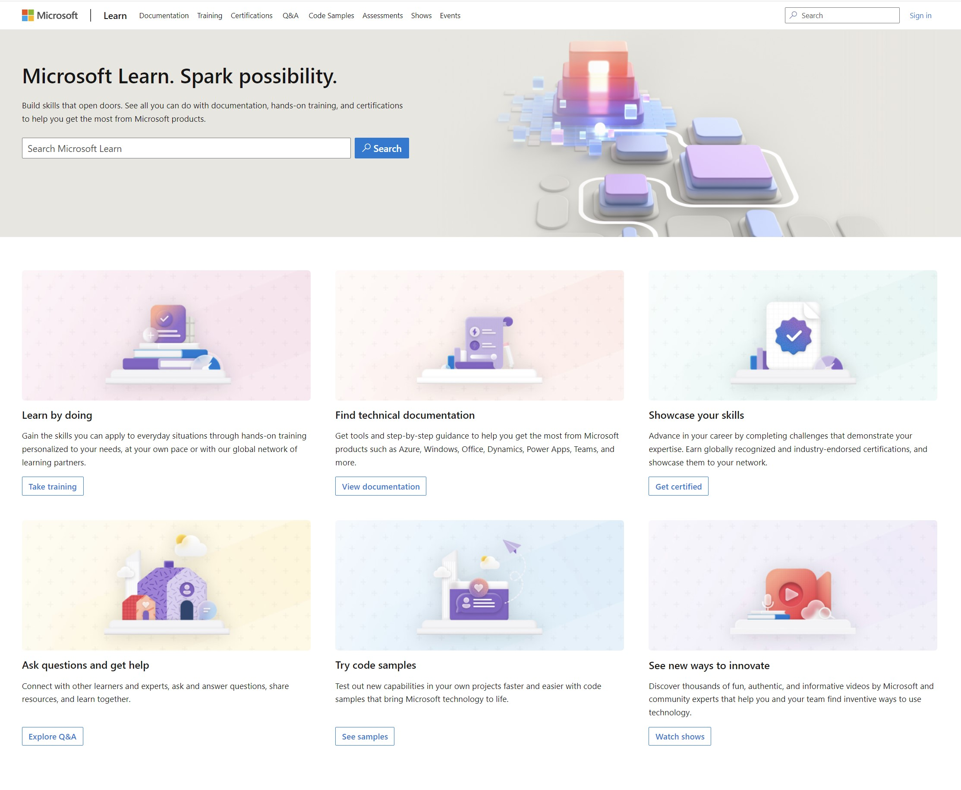
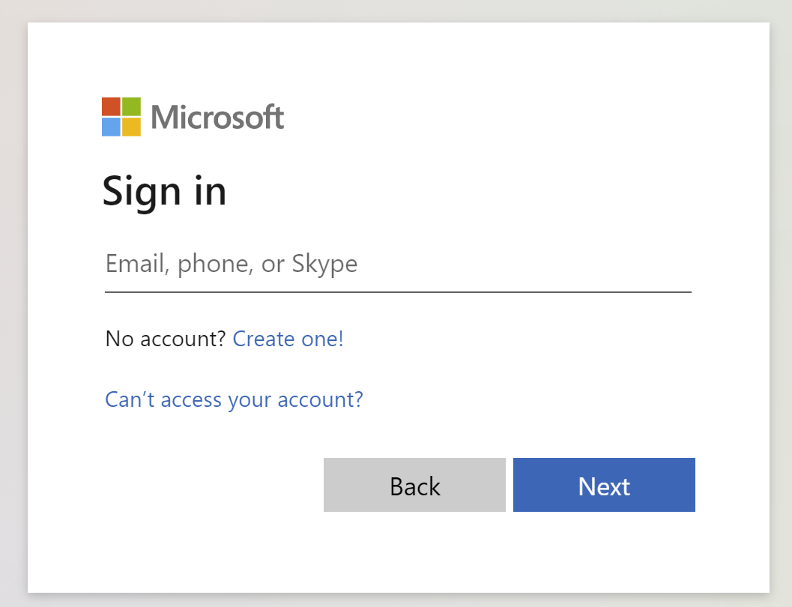
Get the most out of your Microsoft Learn profile
Verify, track, and share your training and certification progress and accomplishments—all on one platform
Create your Microsoft Learn profile at learn.microsoft.com
Claim your achievement code for this course and share you have completed it.
Access your course material and track progress on your learning activities.
Share and verify your Microsoft Certifications via email, on social networking platforms, and on your résumé.
Download and print transcripts and certificates.
Manage your upcoming activities and certification exam appointments.
www.aka.ms/MyMicrosoftLearnProfile
Notes:
Select Sign in at the top, right corner of any Microsoft Learn page.
Follow the Microsoft account authentication process.
If the account that you have chosen to sign-in with doesn't already have a Microsoft Learn profile, you’ll be guided to create one.

Slide 8
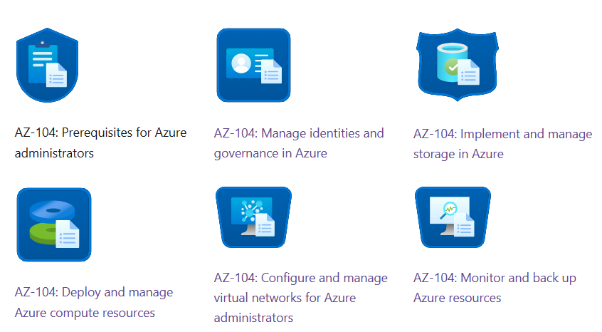
Access your course materials
All course content is available on Microsoft Learn
Secure storage for Azure Files and Azure Blob Storage - Training | Microsoft Learn
We’ll go through this content together and as the course progresses, I will advise you on which modules to review.
You can provide feedback for modules on Microsoft Learn. Use the link at the bottom of the page.
Detailed lab instructions are included in your lab environment.
Notes:
Discuss the self-paced Learning Paths available from the exam page or by searching -https://learn.microsoft.com/en-us/certifications/exams/az-104/?tab=tab-learning-paths
Explain the course materials are reference and the instructor has curated the best content. The Learning Recap page gives links to additional Learn content. To fully prepare for the exam students should go through this additional content as much as possible. Feedback from Learn is logged and tracked. Corrections are made within just a few days. As you review the materials you can provide feedback. The best feedback is specific and actionable. For example, the virtual machine limits have changed and provide the documentation page.

Slide 9
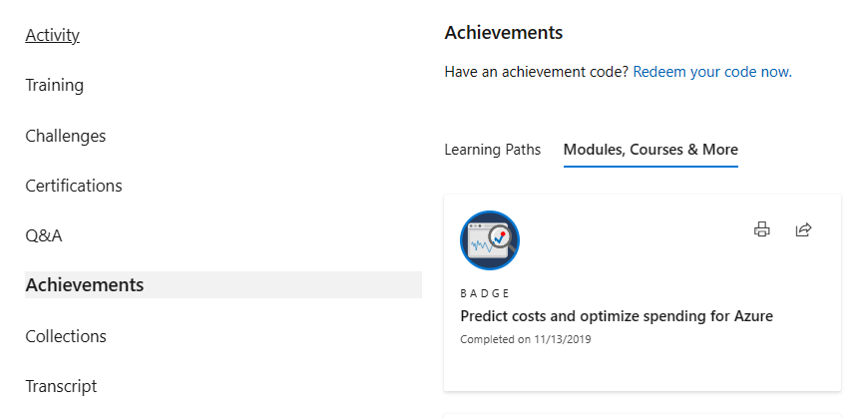
Celebrate your accomplishments and feel empowered
Get your achievement recognized and earn your badge for completing this course
aka.ms/MyMicrosoftLearnProfile
Go to Achievements on your Microsoft Learn profile
Redeem the code provided by your trainer
Find your new badge on Modules, Courses & More
Share your new achievement with your professional network. You can also download and print your certificate.
2
3
4
1

Slide 10

Become Microsoft Certified
92%
of certified IT professionals feel more confident in their abilities after earning certifications¹
Get recognized by earning industry validation for technical knowledge. Ensure you stay current with the necessary skills and expertise for continued success​.
Start at learn.microsoft.com/certifications
Microsoft role-based and specialty certifications require annual renewal.²
Learn about certification renewal at aka.ms/RenewYourCert
¹ “2023 Value of IT Certification | Candidate Report,” Pearson VUE, 2023 ² Microsoft fundamentals certifications don’t expire

Slide 11

Get ready for your Microsoft Certification exam
Exam AZ-104: Microsoft Azure Administrator
Understand the skills measured by the exam
Build confidence in your skills
Study area | Percentage
Manage Azure identities and governance | 20 - 25%
Implement and manage storage | 15 – 20%
Deploy and manage Azure compute resources | 20 – 25%
Configure and manage virtual networking | 15 - 20%
Monitor and backup resources | 10 – 15%
Find in the exam page resources to help prepare
Watch exam prep videos
Review the exam study guide
Demo the exam experience with the exam sandbox
Take a practice assessment
Notes:
Percentages indicate the relative weight of each area on the exam. .The higher the percentage, the more questions you are likely to see in that area
AZ-104 Exam page - https://docs.microsoft.com/learn/certifications/exams/az-104
AZ-104 Study guide with objective domain - https://learn.microsoft.com/certifications/resources/study-guides/az-104

Slide 12
End of presentation

